Slide 1
IO - Java

Slide 2
Session Plan
Implementation of OOPS in Java

Slide 3
Session Objective
Describe the basics of input and output in Java
Read data from and write data to the console
Use streams to read and write files
Read and write objects by using serialization
Reading the data by using Scanner class

Slide 4
Java I/O Basics
Java provides libraries to perform input/output functions.
Java defines an I/O channel as a stream.
An I/O Stream represents an input source or an output destination.
A stream can represent many different kinds of sources and destinations, including disk files, devices, other programs, and memory arrays.
Streams support many different kinds of data, including simple bytes, primitive data types, localized characters, and objects. Some streams simply pass on data; others manipulate and transform the data in useful ways.

Slide 5
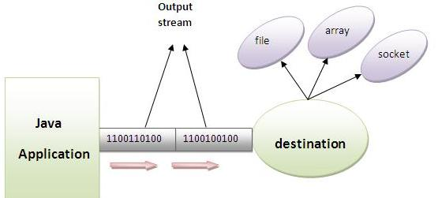
Java Output Streams
A program uses an input stream to read data from a source, one item at a time.

Slide 6
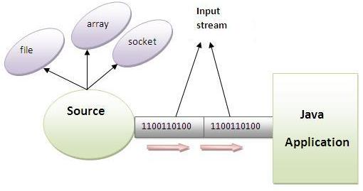
Java Input Stream
A program uses an output stream to write data to a destination (sink), one item at time.

Slide 7
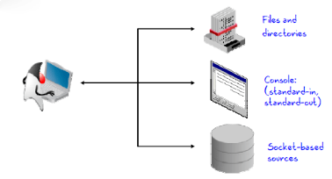
I/O Application
A stream is a flow of data.
A stream can come from a source or can be generated to a sink.
A source stream initiates the flow of data, also called an input stream.
A sink stream terminates the flow of data, also called an output stream.
Sources and sinks are both node streams. Types of node streams are files, memory, and pipes between threads or processes.

Slide 8
Data Within Streams
Java technology supports two types of streams:
character and byte.
Input and output of character data is handled by readers and writers.
Input and output of byte data is handled by input streams and output streams
Normally, the term stream refers to a byte stream.
The terms reader and writer refer to character streams

Slide 9
Stream | Byte Stream | Character Stream
Source Stream | InputStream | Reader
Sink Stream | OutputStream | Writer

Slide 10
InputStream Hierarchy
File InputStream
Piped InputStream
LineNumber InputStream
Input Stream
Filter InputStream
Data InputStream
Byte Array InputStream
Buffered inputStream
Sequence InputStream
StringBuffer InputStream
objectInput Stream

Slide 11
OutputStream Hierarchy
FileOutputStream
PipedOutputStream
PrintStream
Output Stream
FilterOutputStream
DataOutputStream
ByteArrayOutputStream
BufferedOutputStream
ObjectOutput Stream

Slide 12
Reader Hierarchy
InputStreamReader
FileReader
PipedReader
Reader
FilterReader
PushBackReader
StringReader
BufferedReader
LineNumberReader
CharArrayReader

Slide 13
Writer Hierarchy
InputStreamWriter
PipedWriter
Writer
FilterWriter
StringWriter
BufferedWriter
CharArrayWriter
FileWriter

Slide 14
Scanner class
Scanner class is available Java .util package
Syntax :
Scanner scanner=new Scanner(System.in);
int a=scanner.nextInt();
Float c=scanner.nextFloat();
String b=scanner.next();

Slide 15
Persistence
Saving data to some type of permanent storage is called persistence.
An object that is persistent-capable, can be stored on disk (or any other storage device), or sent to another machine to be stored there.
A non persisted object exists only as long as the Java Virtual Machine is running.
Java serialization is the standard mechanism for saving an object as a sequence of bytes that can later be rebuilt into a copy of the object.
To serialize an object of a specific class, the class must implement the java.io.Serializable interface.
The java.io.Serializable interface is a marker interface defines no methods, and serves only as a marker to indicate that the class should be considered for serialization.

Slide 16
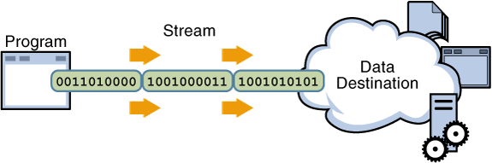
Stream Oriented vs. Buffer Oriented
Java IO being stream oriented means that you read one or more bytes at a time, from a stream.
What you do with the read bytes is up to you. They are not cached anywhere. Furthermore, you cannot move forth and back in the data in a stream. If you need to move forth and back in the data read from a stream, you will need to cache it in a buffer first.

Slide 17
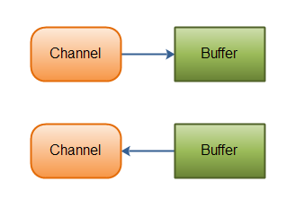
Stream Oriented vs. Buffer Oriented
Java NIO's buffer oriented approach is slightly different.
Data is read into a buffer from which it is later processed. You can move forth and back in the buffer as you need to. This gives you a bit more flexibility during processing.
However, you also need to check if the buffer contains all the data you need in order to fully process it.
And, you need to make sure that when reading more data into the buffer, you do not overwrite data in the buffer you have not yet processed.

